Slide 1
Design & Analysis of Algorithm Huffman Coding
Informatics Department
Parahyangan Catholic University

Slide 2
How a Computer Stores Data ?
Example: string “WOMBAT”
6 characters @8 bit = 48bits needed to store string “WOMBAT”
character stream | W | O | M | B | A | T
ASCII code | 87 | 79 | 77 | 66 | 65 | 84
in binary | 01010111 | 01001111 | 01001101 | 01000010 | 01000001 | 01010100

Slide 3
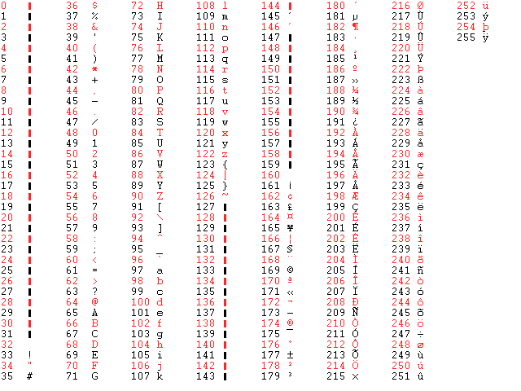
ASCII Table
Not all characters are used in every occasion ! i.e., chatting app usually don’t use ÜÃÊÐ¿æ,etc.

Slide 4
New Code ?
52 characters only
Can be coded using 6 bits
So a string “WOMBAT” can be stored using 36 bits only
A | 0 | a | 26
B | 1 | b | 27
C | 2 | c | 28
D | 3 | d | 29
E | 4 | e | 30
F | 5 | f | 31
G | 6 | g | 32
H | 7 | h | 33
… |  | …
Z | 25 | z | 51
What’s the problem ?
Notes:
Problem is that computer nowdays uses ASCII code as a standard. String that is using our own set of code cannot be read properly, unless we specifically tell the program how to read it.

Slide 5
Compression
In signal processing, data compression, source coding, or bit-rate reduction involves encoding information using fewer bits than the original representation.
Original Data
Compression Technique
Copressed Data (usually smaller)

Slide 6
Compression
Two types:
lossless compression (compressed data can be reverted back to its original version. Ex: zip, rar, etc.)
lossy compression (some information is discarded, so the compressed data cannot be reverted back to its original version. Ex: jpg, mp3)

Slide 7
Huffman Coding
Huffman coding is a lossless data compression algorithm.
The idea is to assign variable-length codes to input characters, lengths of the assigned codes are based on the frequencies of corresponding characters.
The most frequent character gets the smallest code and the least frequent character gets the largest code.

Slide 8
Example
String: AABAABBAAABCAACAABAA
20 characters
A appears 13 times
B appears 5 times
C appears 2 times
Normal coding : 20 x 8bits = 160 bits
2 bits coding (A=00, B=01, C=10): 20 x 2bits = 40 bits
Huffman Coding (A = 0, B=10, C=11): (13 x 1 bit) + (5 x 2 bit) + (2 x 2 bit) = 27 bits

Slide 9
How to Build a Huffman Code?
An algorithm developed by David A. Huffman while he was a Ph.D. student at MIT, and published in the 1952 paper "A Method for the Construction of Minimum-Redundancy Codes“
Huffman coding uses a specific method for choosing the representation for each symbol, resulting in a prefix code
Prefix code = the code of a particular symbol is never a prefix of another symbol’s code

Slide 10
How to Build a Huffman Code?
The algorithm uses greedy approach
STEP1 : count each character’s frequency
STEP2: build a binary tree which leaves contains each symbol’s frequency. The tree is built by iteratively combine 2 nodes with smallest frequency

Slide 11
Example
Priority Queue
D
(1)
B
(3)
F
(3)
E
(7)
C
(8)
G
(10)
A
(12)

Slide 12
Example
Priority Queue
F
(3)
E
(7)
C
(8)
G
(10)
A
(12)
4
D
(1)
B
(3)

Slide 13
Example
Priority Queue
E
(7)
C
(8)
G
(10)
A
(12)
7
F
(3)
4
D
(1)
B
(3)

Slide 14
Example
Priority Queue
C
(8)
G
(10)
A
(12)
14
E
(7)
7
F
(3)
4
D
(1)
B
(3)

Slide 15
Example
Priority Queue
A
(12)
18
14
E
(7)
C
(8)
G
(10)
7
F
(3)
4
D
(1)
B
(3)

Slide 16
Example
Priority Queue
18
26
C
(8)
G
(10)
A
(12)
14
E
(7)
7
F
(3)
4
D
(1)
B
(3)

Slide 17
Finished Binary Tree
44
18
26
C
(8)
G
(10)
A
(12)
14
E
(7)
7
F
(3)
4
D
(1)
B
(3)

Slide 18
Finished Binary Tree
44
0
1
Label each edges:
left → 0
right → 1
18
26
0
1
0
1
C
(8)
G
(10)
A
(12)
14
0
1
E
(7)
7
0
1
F
(3)
4
0
1
D
(1)
B
(3)

Slide 19
Finished Binary Tree
44
Each symbol’s code is the path from the root to that symbol’s leaf
0
1
18
26
0
1
0
1
C
(8)
G
(10)
A
(12)
14
0
1
10
E
(7)
7
00
01
0
1
110
F
(3)
4
Example:
CAGE
= 00 10 01 110
BEAD
= 11111 110 10 11110
0
1
1110
D
(1)
B
(3)
11110
11111

Slide 20
Decoding
What does this code means ? 1100011100110101111101
The reader needs the huffman tree to be able to decode

Slide 21
Huffman Tree
Tree structure and leaves’ symbol are sufficient
C
G
A
E
F
D
B
DFS preorder:
C
G
A
E
F
D
B
0 0 1C 1G 0 1A 0 1E 0 1F 0 1D 1B
Notes:
In practice, we cannot write anything other than 0-bit or 1-bit, so each letter is replaced by its 8-bit ASCII symbol.

Slide 22
Exercise
Draw the Huffman’s Tree: 001C1G01A01E01F01D1B
Decode this message: 1100011100110101111101

Slide 23
Exercise
Build the huffman tree for this data (space is also a symbol): TWINKLE TWINKLE LITTLE STARS
Encode this string: “TWINKLE”

